Slide 1
Impact of an Explicit Health Benefit Plan on Support for Universal Health Care
By: Sean Duan

Slide 2
Why this project?
Health Care in the U.S. is broken
UHC works for other countries
Drug costs out of control
Medical costs most common cause of bankruptcy (Galvani et al 2017)
Spend less, better outcomes
Drug price negotiation
Increase in population insured

Slide 3
Why this project?
Opposition to UHC
Health Benefit Packages solves these (HBP)!
Too complicated!
Hard to define!
Too expensive??
Explicit entitlements
Public facing rules
Budget limits
Transparent requirements

Slide 4
Research Questions
What:
Why:
Does HBP > UHC Support?
Moderating Factors > UHC Support?
Best way to > UHC support?
?s on what leads to > UHC Support

Slide 5
Hypothesis
HBP > Equality / Understanding
Equality > More UHC Support
Easy to Understand > More UHC Support

Slide 6
Pilot Study

Slide 7
Participants
Total N = 185
Age (SD): 18.44 (0.772)
Female % (n): 64.8% (120)
White % (n): 82.7% (153)
Year of School % (n):
Freshman: 59.4% (110)
Sophmore: 35.1% (65)
Junior: 3.7% (7)
Senior: 2.7% (3)

Slide 8
Method: Design
2x3 mixed subjects design
Multi level model
Measurement Time > Subject
Independent variable
Time of measurement (pre/post intervention)
Experimental condition (control/active/passive)

Slide 9
Method: Materials
Choosing Healthplans All Together (CHAT) exercise (Danis, Biddle, & Goold)
“Blank” version – Active
“Filled” version – Passive
“Pizza” version - Control

Slide 14
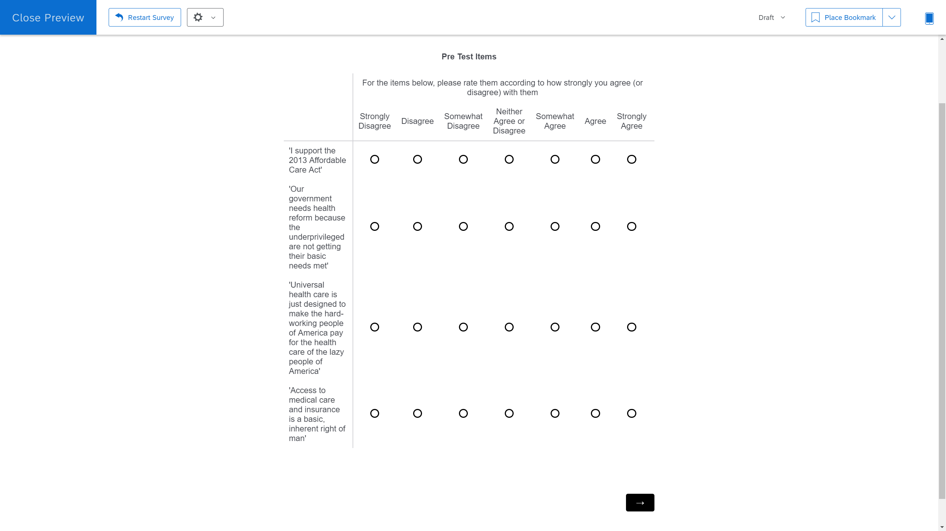

Slide 15
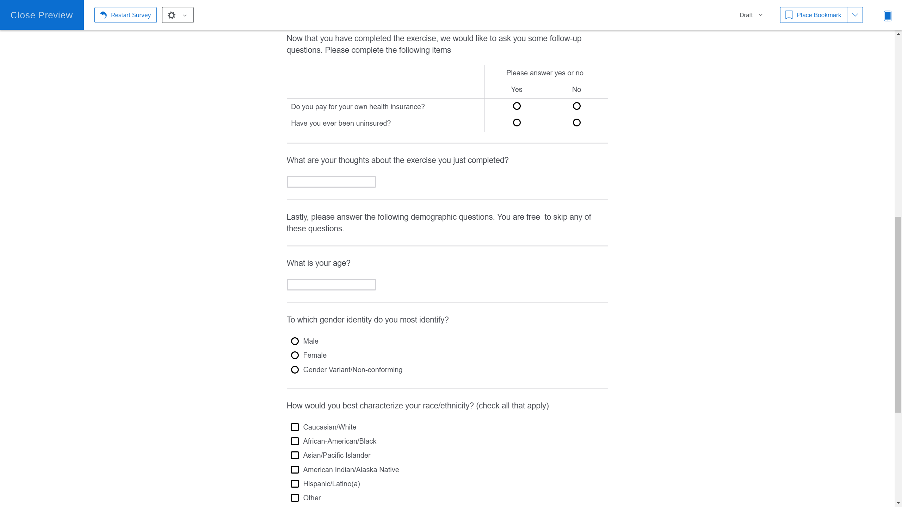

Slide 16
Results – Pilot Study

Slide 17
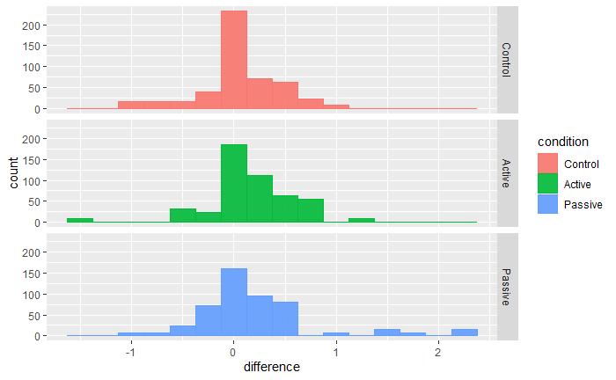

Slide 18
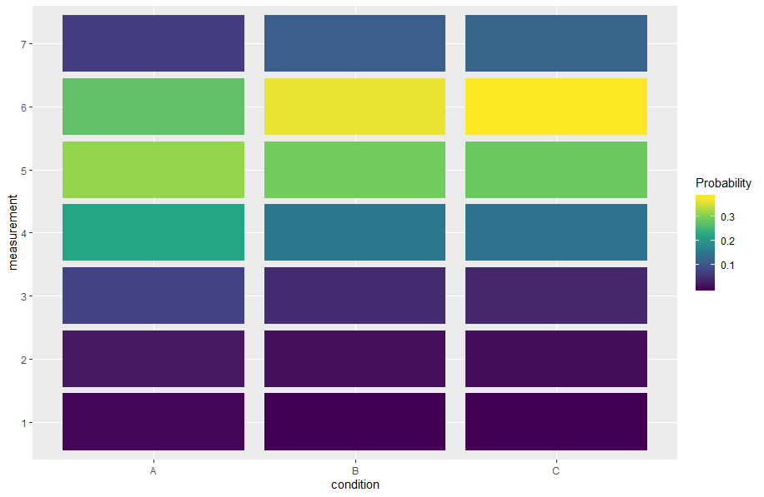
Control
Active
Passive

Slide 19
Quantitative Results
Intervention > Increased UHC Support!
Active = Passive intervention?
Time Spent =/= UHC support

Slide 20
What did we change?
Control and Intervention only
Control – “Standard” UHC messaging
Mediating Factors
Complexity
Equality/Fairness
Javascript CHAT exercise
Sliders > Likert measures

Slide 21
Study 2

Slide 23
Method: Measures
Pre-Test
Support for Universal Health Care (Shen & Labouff 2013)
Understanding of UHC (Mulken, Pair, Forceville, 2010)
Equity of UHC (Netemeyer, Boles,McMurrian, 1996)
Post-Test
Pre-test measures +
Free response: Thoughts on activity
Likelihood to want UHC plan
Numeracy
Subjective Numeracy Scale (Fagerlin et al., 2007)
Rasch Numeracy Scale (Weller et al., 2013)
Pay for Insurance / Ever been uninsured (Y/N)

Slide 24
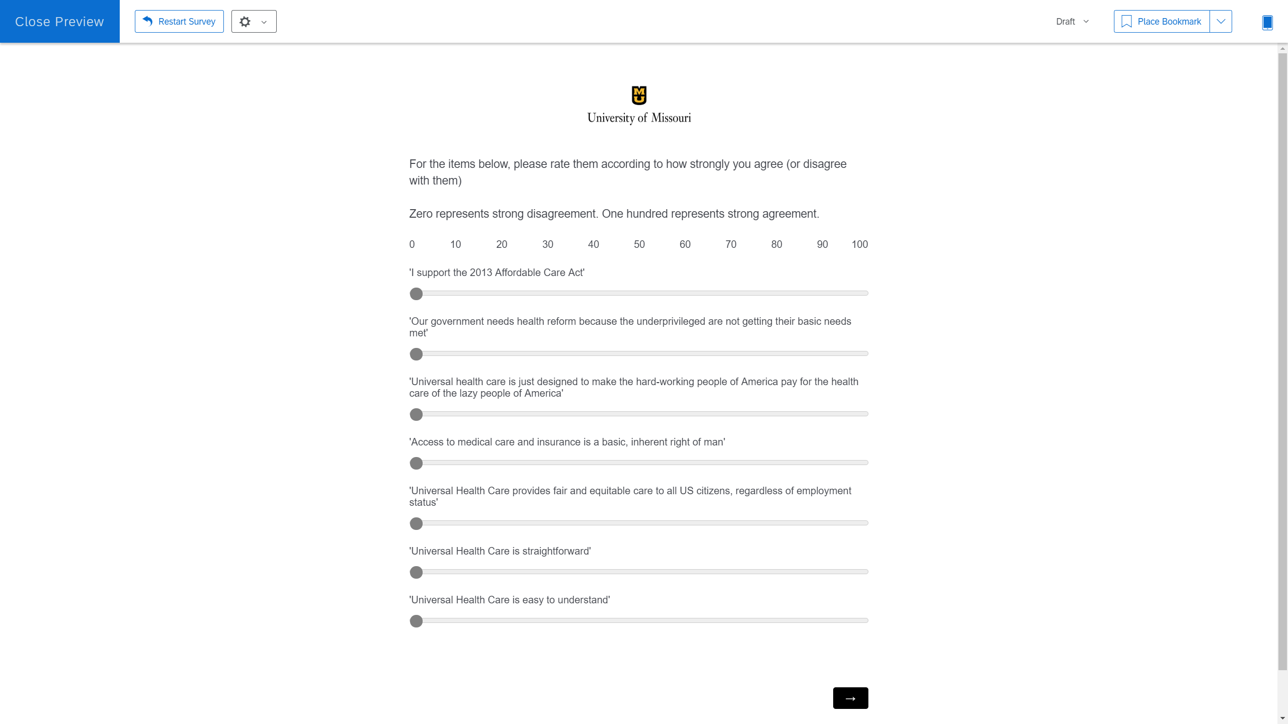

Slide 25
Method: Design
2x2 mixed subjects design
Multi level model
Measurement Time > Subject
Independent variable
Time of measurement (pre/post intervention)
Experimental condition (control/HBP exercise)

Slide 26
Method: Materials
Choosing Healthplans All Together (CHAT) exercise (Danis, Biddle, & Goold)
Web-exercise version
‘Traditional’ UHC information
Pamphlets from WHO

Slide 27
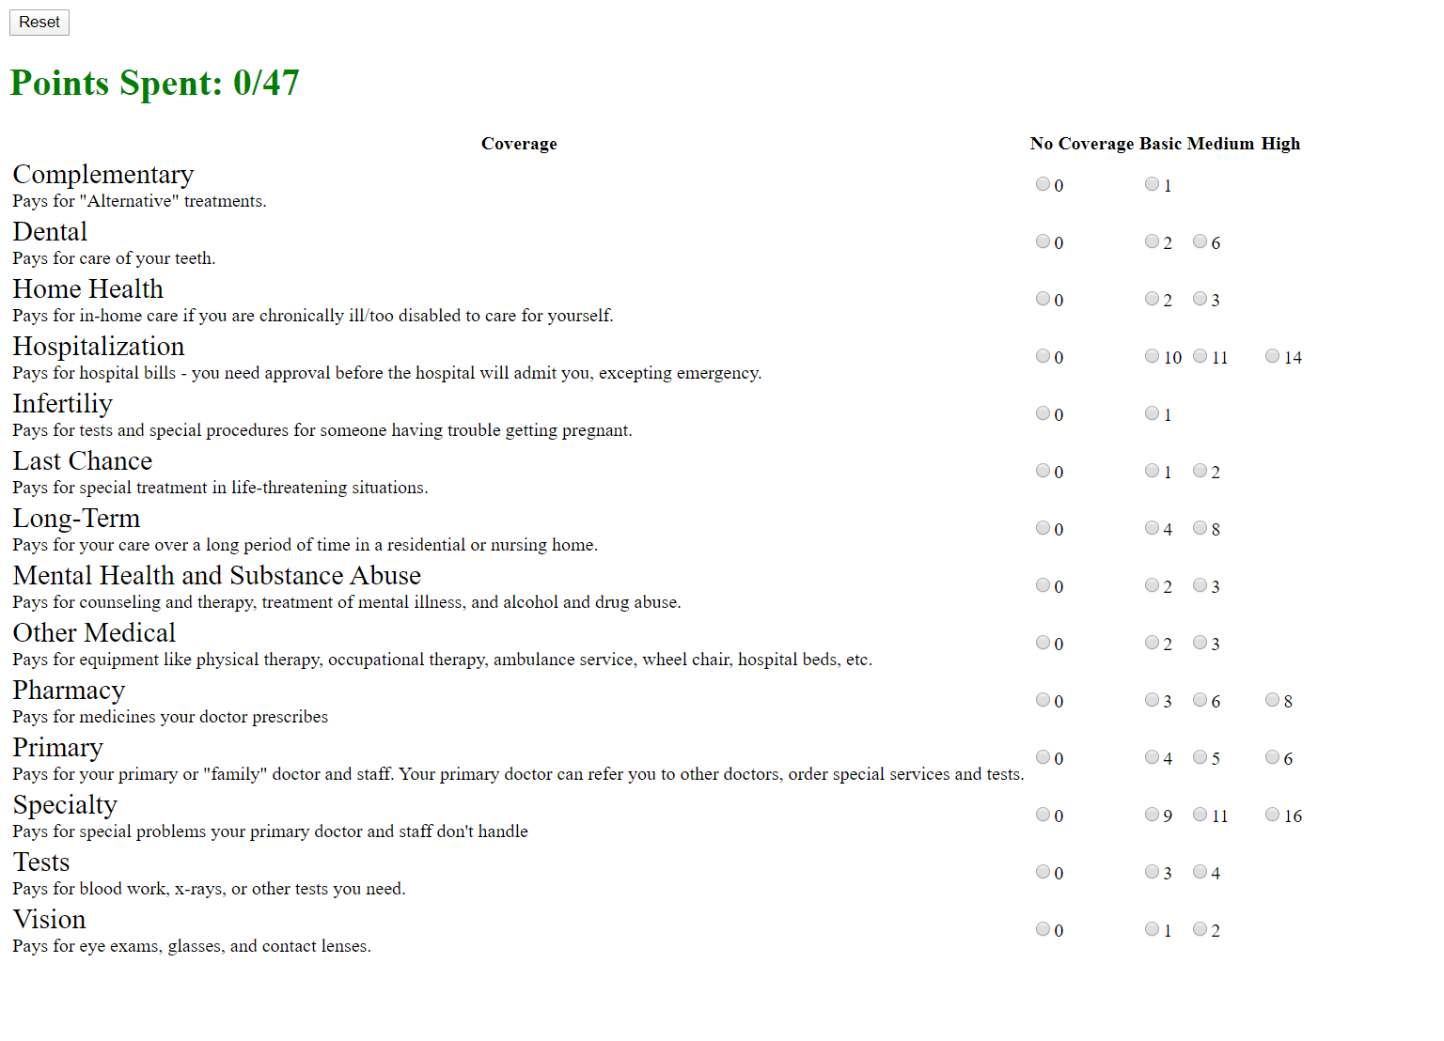

Slide 28


Slide 29
Method: Procedure
Online Link to Qualtrics survey
Pre-test measures given
Randomization
Control
3 UHC infographics
Intervention
HBP activity in separate screen
HBP ‘legend’ on survey screen
Post-test measures given
Debrief

Slide 30
Method: Modelling
Multi-level model
Time nested within Subject
Time x Condition > Support UHC?
Linear Models
Numeracy predict UHC
Condition > Mediating factors?
Mediating factors > Support UHC?

Slide 31
Method: Modelling
Variable Selection
Theoretical reason for variable
Time (pre/post)
Total time spent
Subject (is this actually a variable?? Check )
Condition
Moderating factor scores
(maybe remove this slide?)

Slide 32
Results – Primary Study

Slide 33
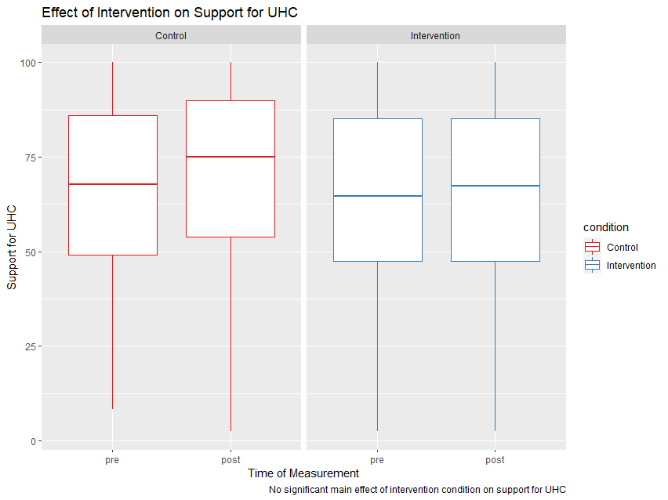

Slide 34
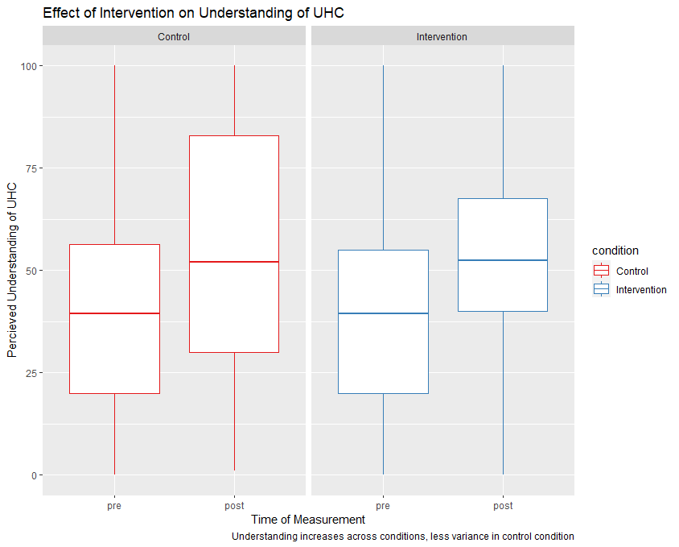

Slide 35
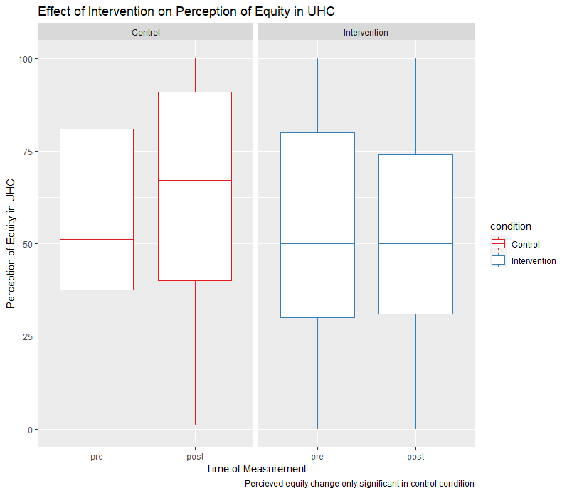

Slide 36
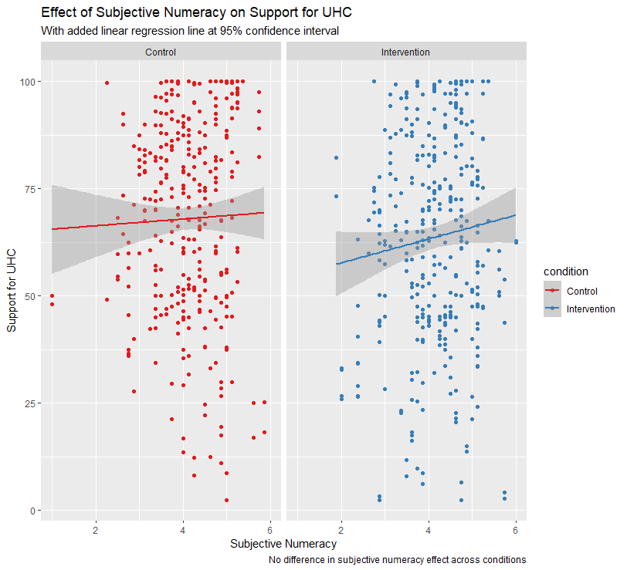

Slide 37
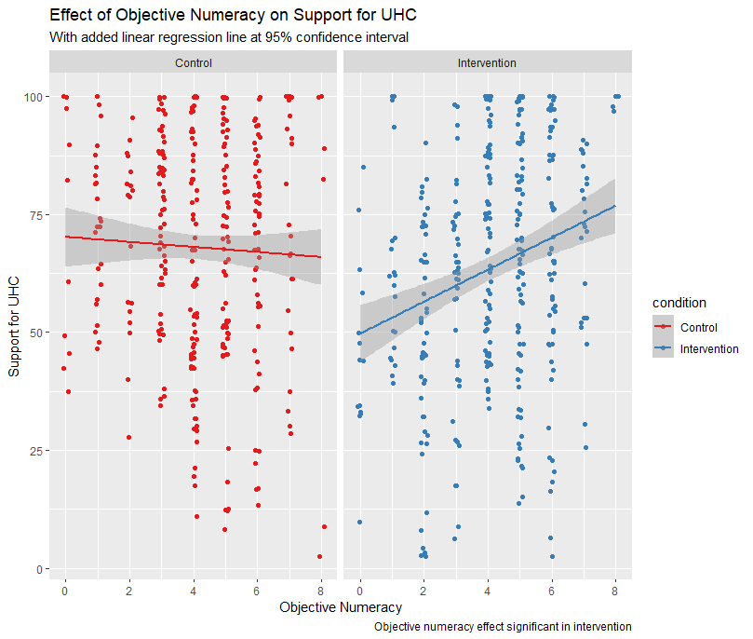

Slide 38
Quantitative Results
Intervention =/= UHC Supp
Mediating Fact > UHC Supp
Intervention =/= Equity
Both > Understanding
Subj Numeracy =/= UHC Supp
Obj Numeracy > UHC Supp
In intervention only?

Slide 39
Qualitative Results
Difficult
“it was much more difficult than I thought it was going to be; I had to compromise points in some places to be able to get at least basic coverage in other areas”
Interesting
“Interesting that my answers changed. I would be interested in seeing someone against Universal Health Care make a study, too.”
Enjoyable/Fun/Worked
“Enjoyed it, overall I believe that there should be Universal Health Care, but I did not realize how complicated it was. This exercise showed me how complicated it will be if the US decides to go through with something like this.”

Slide 40
Qualitative Results
Intervention
Difficult – 23%
Interesting – 49.8%
Enjoyable/Fun/Worked – 18.4%
Control
Difficult – 0%
Interesting – 53%
Enjoyable/Fun/Worked – 8.7%

Slide 41
Extensions?
More structured qualitative analysis
More ‘neutral’ control material??
Measure political orientation??
Compare against private healthcare info?
Determine how/why objective numeracy > UHC supp in Intervention only??

Slide 42
Conclusion
Mediating Factors > UHC Supp
Intervention > Understanding
Intervention =/= Equity
Control > Both Mediating Factors
Subjective Numeracy =/= UHC Supp
Objective Numeracy > UHC Supp
Only in Intervention, NOT control!

Slide 43
Questions?

